Slide 1
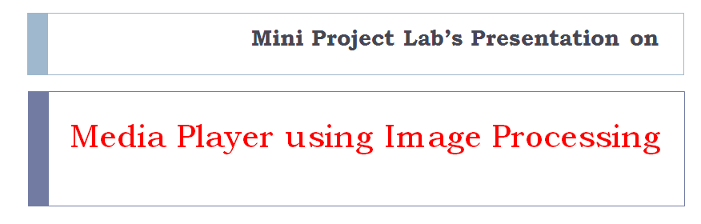
Media Player using Image Processing
DEPARTMENT OF COMPUTER SCIENCE & ENGINEERING,
RAJARAMBAPU INSTITUTE OF TECHNOLOGY, RAJARAMNAGAR.
Mini Project Lab’s Presentation on

Slide 2
Project Statement
To design and develop media player inbounded with color recognizing functions.

Slide 3
Objective
We are preparing this project by drawing and visioning certain objectives as:
To analysis, design and develop real-time application.
To develop simple interactive media player.
To operate open, close, start, resume media files using color recognition functions.
Also provide solution for people who disable to move.

Slide 4
Features

Slide 5
Functional Components
Project is divided into three modules -
Module I – Design and implementation of media player
Module II – Capturing Image from webcam and detect it.
Module III – Color recognition of an Image and perform corresponding functions.

Slide 6
Requirement Specification
Hardware’s:
Regular CPU Processor (At least Pentium)
RAM - least 2 GB.
Hard Drive - least 250 GB
Webcam support required..
Audio support required.
Software’s:
Java Virtual Environment
Open CV 2.4.4 Framework
Java-Fx, JavaX Libraries
Eclipse as Editor

Slide 7
Timeline
No. | Phases | Expected time (in weeks) | Expected completion dates | Work done
01 | Requirement Analysis | 01 | 27/01/2016 | ✔
02 | Design Phase | 01 | 10/02/2016 | ✔
03 | Coding Phase | 05 | 16/03/2016 | ***
04 | Testing Phase | 02 | 30/03/2016 | ✘
05 | Modification Phase | 01 | 06/04/2016 | ✘
06 | Deployment Phase | 01 | 13/04/2016 | ✘
Total Time |  | 11 Weeks

Slide 8
Design Phases

Slide 9
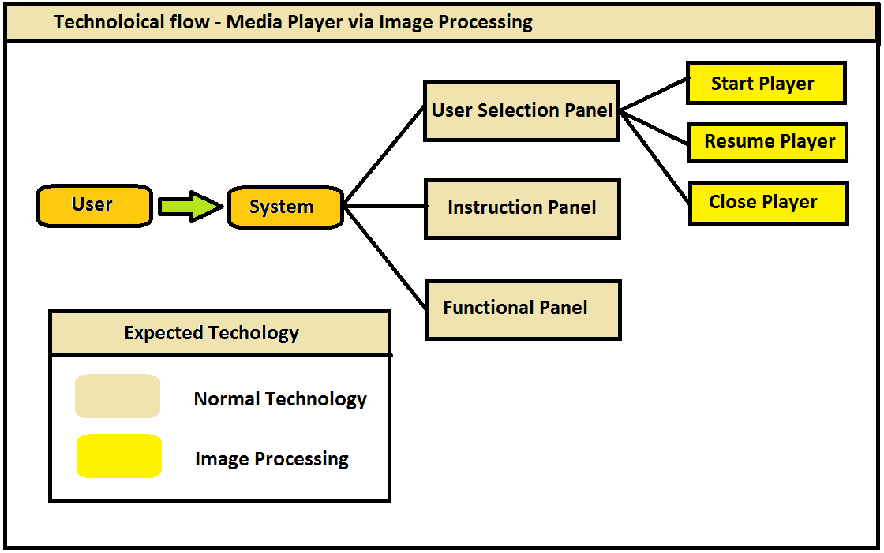
Technology Flow

Slide 10
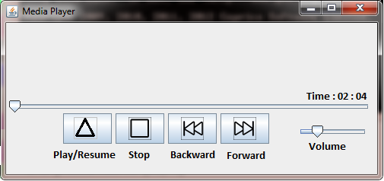
Coding Phase
Current work –
Audio Insertion in media player
Color Detection
Color Recognation

Slide 11
Current Status
Modules Status
✔ About to complete two modules
Coding Status
✔ About to complete 122 lines of code
Phase Status
✔ About to complete third phase out of six

Slide 12
Thank You !
Under Guidance of,
Prof. Mrs. Gautami G. Shingan
Presented by,
Yadnyawalkya Tale 1303052
Ajay Paratmandali 1303057
Kartik Patil 1303036
Dushant Gadekar 1303058

